Slide 1

Project Proposal
AI 6002 – CAPSTONE PROJECT
Team 3:
Ashwini Kumar, Ismat Sifat Yousuf & Md. Imran Hossain showrov

Slide 2






Meet the team
ASHWINI KUMAR
#202286192
ISMAT SIFAT YOUSUF
#202291828
MD. IMRAN HOSSAIN SHOWROV
#202285281
2

Slide 3

INTRODUCTION
WHAT ARE WE BUILDING?
A Mobile Application For Emotion Analysis Using Facial Features
Recognizing Emotions: Happiness, Sadness, Anger, Disgust & Surprise
WHY ARE WE BUILDING?
Emotions are an integral part of human communication and interaction
Understanding and interpreting emotions from facial cues have far-reaching implications in numerous domains, from healthcare to human-computer interaction, marketing, and beyond

Slide 4
Problem statement
"Develop A Cross-Platform Mobile Application That Enables Users To Upload Or Capture Images, And Accurately Detects And Classifies Emotions Based On Facial Features, Providing Users With Immediate Feedback On Emotional States."

Slide 5
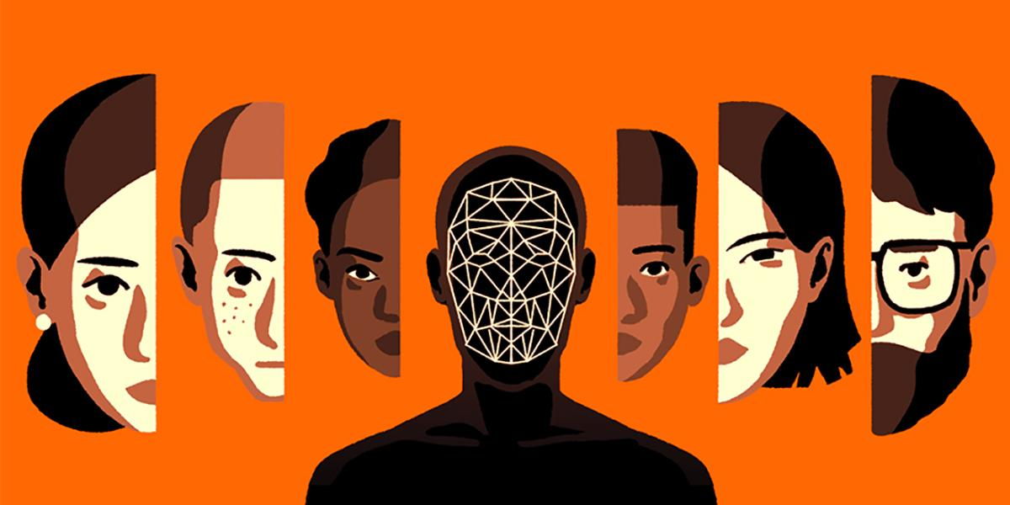
MOTIVATION
AFFECTIVA
Pioneering Work in Emotion AI
Primarily focusing on Automotive and Media Analytics
Proven Technology : Emotions, expressions, cognitive movements and activities
Real – World Application
Industry Relevance
This Photo by Unknown Author is licensed under CC BY-SA-NC

Slide 6
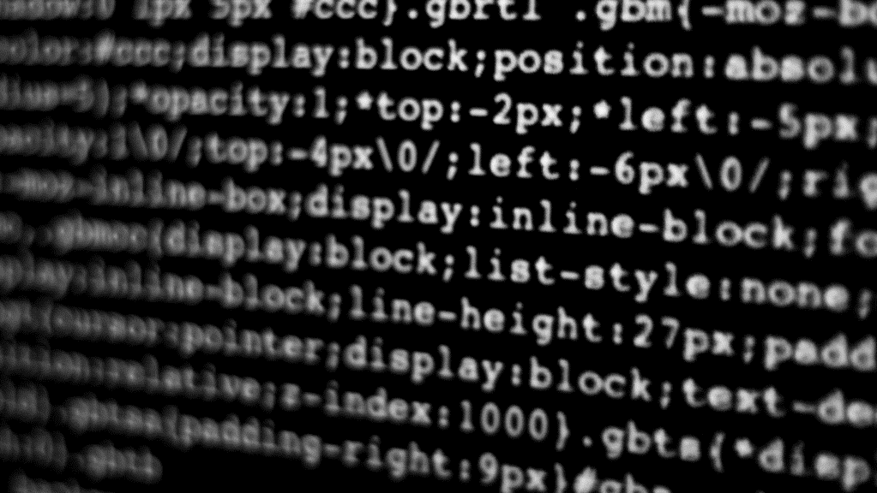
OBJECTIVES
The primary objective of this project is to design, implement, and evaluate a robust machine-learning model for emotion analysis using facial features. Specifically, the project aims to:
Develop a precise emotion recognition system for facial images.
Apply advanced computer vision and machine learning techniques for accurate emotion classification.
Evaluate model performance for practical use.
Contribute to emotion analysis research with real-world applications in mind.

Slide 7
SCOPE
The project's scope is focused on achieving accurate emotion recognition from facial expressions while laying the groundwork for future developments in this field. The scope of this project encompasses:
Gather diverse emotion-labeled facial image data.
Clean, augment, and normalize the dataset.
Extract relevant facial features for the model.
Develop an accurate emotion recognition model.
Evaluate model performance using key metrics.
Explore integration possibilities into practical applications.
Provide comprehensive project documentation.

Slide 8
dataset
The Dataset contains more than 20,000 images, of which 2,000 are annotated.
We plan to use Image Augmentation on the annotated images to train the model better.
We will use Zooming the images, Increasing the Brightness, Darkening the images, and Flipping the images Horizontally and Vertically to get more annotated data.
We plan to use 80% of the total Dataset for Training and 20% for Testing.
80%
Training
20%
Testing

Slide 9
methodological OVERVIEW
Key Facial Points Detection & Facial Expression/Emotion Detection Using ANN And Residual Networks
FastAPI For The Backend.
Kivy Framework For Frontend

Slide 10
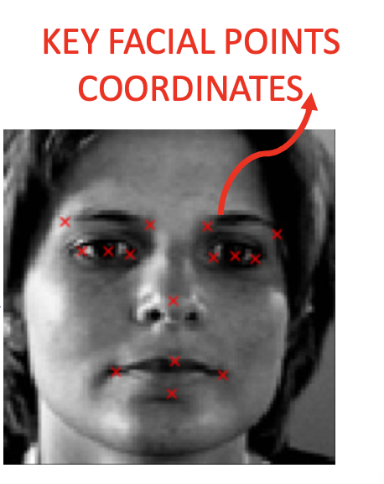

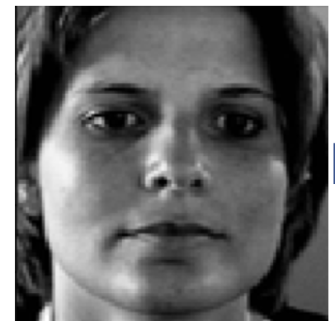
ENTIRE NETWORK OVERVIEW
KERNEL/FEATURE
DETECTORS
POOLING
FILTERS
CONVOLUTION
POOLING
FLATTENING
CONVOLUTION
LAYER
POOLING
LAYER
INPUT IMAGE
ARTIFICIAL
NEURAL NETWORK

Slide 11
DEFINITION
CONVOLUTION
Convolution is a mathematical operation that involves applying a filter or kernel to an input image to extract features.
PURPOSE
Convolution is used to detect patterns and features in the input data. In image processing, it helps identify edges, textures, and other important characteristics that are crucial for object recognition.

Slide 12
DEFINITION
POOLING
Pooling is a downsampling operation that reduces the spatial dimensions (width and height) of the feature maps while retaining their important information.
PURPOSE
Pooling helps reduce the computational complexity of the network and makes the model more robust to variations in scale and position. It also helps in reducing overfitting.

Slide 13
DEFINITION
FLATTENING
Flattening is the process of converting the multi-dimensional feature maps produced by convolutional and pooling layers into a one-dimensional vector. This is typically done before feeding the data into fully connected layers (dense layers) in the neural network.
PURPOSE
Flattening is necessary to transition from the feature extraction part of the network (convolutional and pooling layers) to the classification part (fully connected layers). It reshapes the data into a format that can be processed by traditional feedforward neural network layers.

Slide 14
Key facial points detection
Trained Key
Facial Points
Detector Model
The Dataset Consists Of the X And Y Coordinates Of 15 Facial Key Points.
Input Images Are 96 X 96 Pixels.
Images Consist Of Only One Colour Channel (Grayscale Images)

Slide 15
Facial Expression/Emotion Detection
The second model will classify people’s emotion.
Data contains images that belong to 5 categories:
0 = Angry
1= Disgust
2 = Sad
3= Happy
4 = Surprised

Slide 16
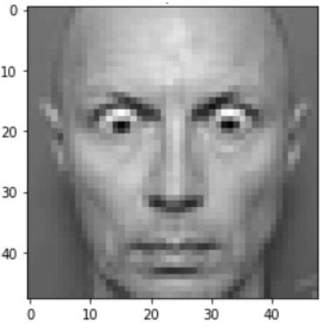
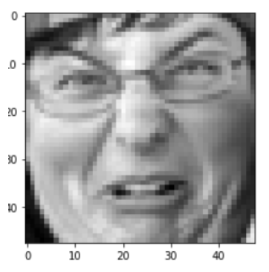
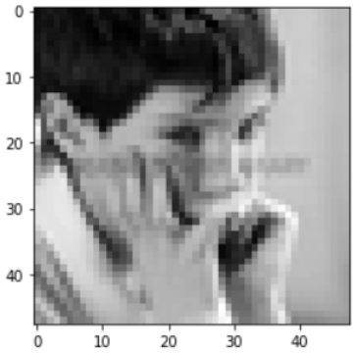
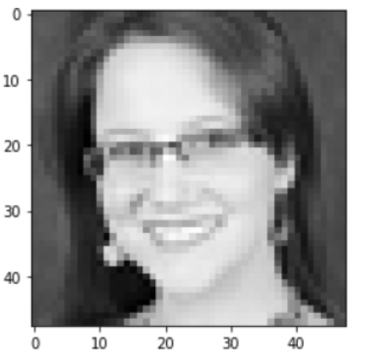
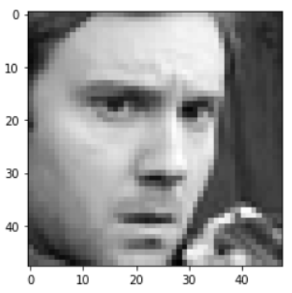
0 - Angry
1 - Disgust
2 - Sad
3 - Happy
4 - Surprised

Slide 17
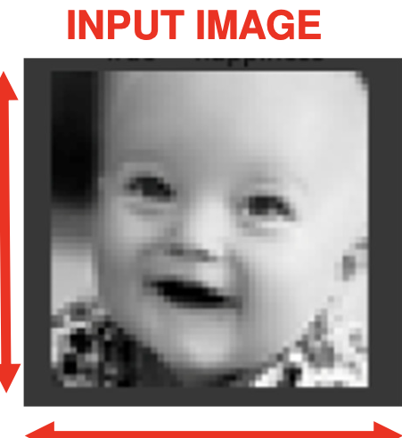
Facial Expression/Emotion Detection
Target Classes
Angry
Disgust
Sad
Happy
Surprised
Trained Key
Facial Points
Detector Model
The Second Model Takes The Input Image And Using The Trained Key Detector Model Tries To Classify The Image Into One Of The Five Target Classes.

Slide 18
What is FastApi?
FastAPI is a modern Python web framework that allows you to quickly create APIs with minimal code.
FastAPI uses Python-type hints to generate this documentation, making it easy to understand and use your API.
WHY FastApi?
High Performance.
Ease of Development.
Easy Data Validation.

Slide 19
What is Kivy framework?
Kivy is an open-source Python framework for developing multi-touch applications.
It offers a range of UI widgets and tools for building touch-based, visually appealing interfaces that can be deployed on various platforms.
Why Kivy framework?
Cross-Platform Compatibility.
Touch-Based Interactions.
Customized User Interfaces.

Slide 20

What’s next
LOOKING AHEAD

Slide 21
CHALLENGES
Limited Annotated Data : Annotated data is crucial for training and evaluation.
Complexity of Emotions: Emotions are complex and nuanced, and recognizing them solely from facial expressions can be challenging.
Model Selection : Choosing the right model architecture and hyperparameters for your specific task can be challenging and require experimentation.
User Interface Design: Designing a user-friendly and intuitive interface, especially when using frameworks like Kivy, requires careful consideration of user experience.

Slide 22
Key learning outcomes
Develop ANN models and train while leveraging the power of GPUs and TPUs
Build, train, test and deploy ResNets to perform image classification using real-world datasets
Perform image augmentation to improve the generalization capability of the model
Perform joint model predictions from both the key facial points model and facial expressions classification model
Deploy both deep neural networks using TensorFlow serving to make predictions.

Slide 23
Business use cases
Sentiment Analysis of Social Media posts
To accurately measure the Customer Emotions when they are leaving a store
For online classes, emotion AI will be helpful to gauge student engagement
Optimizing product packaging and design based on the emotional responses from Different Visual Elements
To monitor driver emotions for safety. Alerting distracted/drowsy drivers
Analyze mental health conditions based on facial expressions and voice for signs of stress

Slide 24
POTENTIAL FUTURE EXTENSIONS
Multimodal Emotion Recognition: Combine facial feature analysis with other modalities, such as voice sentiment analysis, to create a more comprehensive emotion recognition system.
Emotion-Driven Content Creation: Develop systems that generate content (e.g., music playlists, movie recommendations, advertising) based on users' emotional states.
Emotion-Enhanced Gaming: Create emotionally responsive video games that adapt gameplay based on the player's emotional state.
Security and Authentication: Use emotion analysis as an additional layer of security for access control, potentially in combination with other biometric measures.

Slide 25
Project timeline(tentative)
Weeks | Planned Tasks
Week 2 & 3 | Brainstorming – Project Ideas, Methods, Datasets, APIs and Frontend Frameworks
Week 4 | Finalizing Project Idea and Implementation Methods.
Week 5 & 6 | Developing the model to detect key facial points/features.
Week 7 | Progress Report 1 and develop an interactive cross-platform mobile application.
Week 8 & 9 | Developing the model to detect emotions from the given images.
Week 10 | Integrating the developed models on FastAPI.
Week 11 | Deploying the FastAPI on the mobile application.
Week 12 | Beta Testing & Debugging
Week 13 | Finalizing the complete product and fixing any issues IF found during Beta Testing.
Week 14 & 15 | Project Progress 2 / Final Project Report

Slide 26
project milestone
Milestone 1 |  |  | Milestone 2 |  |  | Milestone 3 |  |  | Milestone 4
 | 1/4 |  |  | 2/4 |  |  | 3/4 |  |  | 4/4
Detecting The Key Facial Features Of All The Images In The Dataset |  |  | Detecting The Emotions Like - Surprise, Happiness, Disgust, Anger And Sadness |  |  | Implementing The Developed Model On FastAPI And Creating A Cross-platform Mobile Application |  |  | Integrating The FastAPI Backend With The Mobile Application And Testing With Validation Data And Real Data From Users

Slide 27


THANK YOU
ASHWINI KUMAR
ashwinik@mun.ca
ISMAT SIFAT YOUSUF
isyousuf@mun.ca
Md. IMRAN HOSSAIN SHOWROV
mihshowrov@mun.ca

